Slide 1
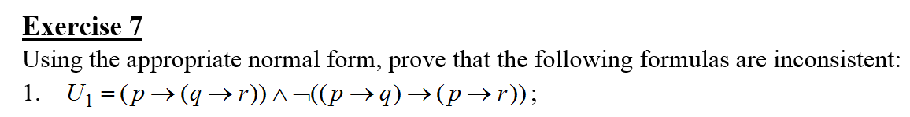
Problem statement

Slide 2
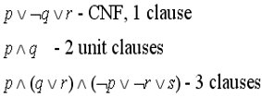
Theoretical results
A clause is a disjunction of a finite number of literals:
A formula is in conjunctive normal form (CNF), if it is written as a conjunction of clauses:
A formula U is called inconsistent if U does not have any model, U si evaluated as false in all interpretations.

Slide 3
Find the equivalent DNF/CNF of the formula
Normalization algorithm:
U1 = (p -> (q -> r)) ˄ ¬((p -> q) -> (p -> r)) (replace -> using U->V=¬U ˅ V)
U1 = (¬p ˅ (q -> r)) ˄ ¬(¬(p -> q) ˅ (p -> r))
U1 = (¬p ˅ (¬q ˅ r)) ˄ ¬(¬(¬p ˅ q) ˅ (¬p ˅ r))
U1 = (¬p ˅ ¬q ˅ r) ˄ ¬((p ˄ ¬q) ˅ (¬p ˅ r)) (De Morgan’s)
U1 = (¬p ˅ ¬q ˅ r) ˄ ¬ (p ˄ ¬q) ˄ ¬ (¬p ˅ r)
U1 = (¬p ˅ ¬q ˅ r) ˄ (¬p ˅ q) ˄ (p ˄ ¬r)
U1 = (¬p ˅ ¬q ˅ r) ˄ (¬p ˅ q) ˄ p ˄ ¬r

Slide 4
U1 = p ˄ (¬p ˅ ¬q ˅ r) ˄ (¬p ˅ q) ˄ ¬r (distribution)
U1 = p ˄ (¬q ˅ r) ˄ (¬p ˅ q) ˄ ¬r
U1 = p ˄ (¬p ˅ q) ˄ (¬q ˅ r) ˄ ¬r
U1 = p ˄ q ˄ (¬q ˅ r) ˄ ¬r (distribution)
U1 = p ˄ q ˄ r ˄ ¬r
U1 = p ˄ q ˄ 0
U1 = 0

Slide 5
Result
U1 is false for all interpretations, so U1 is inconsistent

